Slide 1
The Effect of High Performance Computer on Deep Learning:
A Face Expression Recognition Case
Authors:
Xin Zhang
Francisco Reveriano
Jiang Lu
Xingang Fu
Ting Zhang
Presented By:
Azmain Morshed
22141050
CSE449
Fall 2023
Section: 01
Instructor:
Mr. Annajit Alim Rasel

Slide 2
Introduction
Importance of Facial Expression Recognition (FER)
Challenges in FER: computational demands, complex models
Solution: High-Performance Computing (HPC)

Slide 3
Methodology
Utilization of the XSEDE high-performance computing resources
Implementation of CNN models
Training parameters variation
Dataset: fer2013 from Kaggle

Slide 4
HPC Infrastructure
Overview of Bridges supercomputer
Specifications: GPU nodes, memory, etc

Slide 5
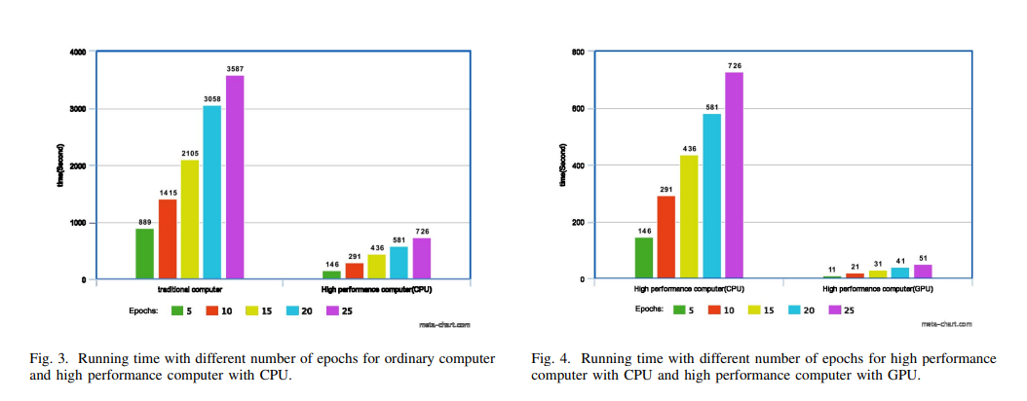
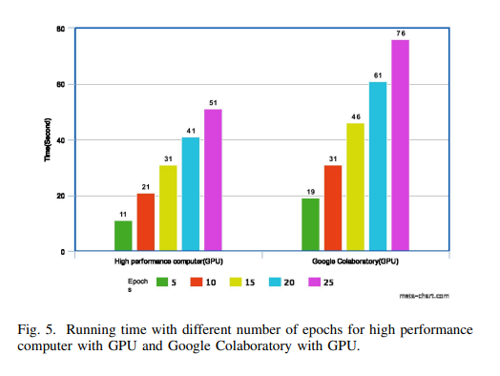
Results
Comparisons: HPC with CPU vs. HPC with GPU, and Google Colaboratory
Performance metrics: Running time, accuracy

Slide 6
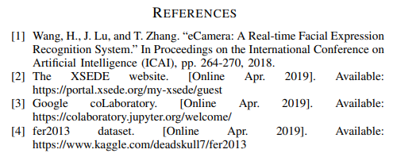
Conclusion and Future Work
HPC's critical role in deep learning
Future directions: Larger image datasets, exploring other supercomputing centers

Slide 7
The End

